Slide 1
Multicores and Coprocessors

Slide 3
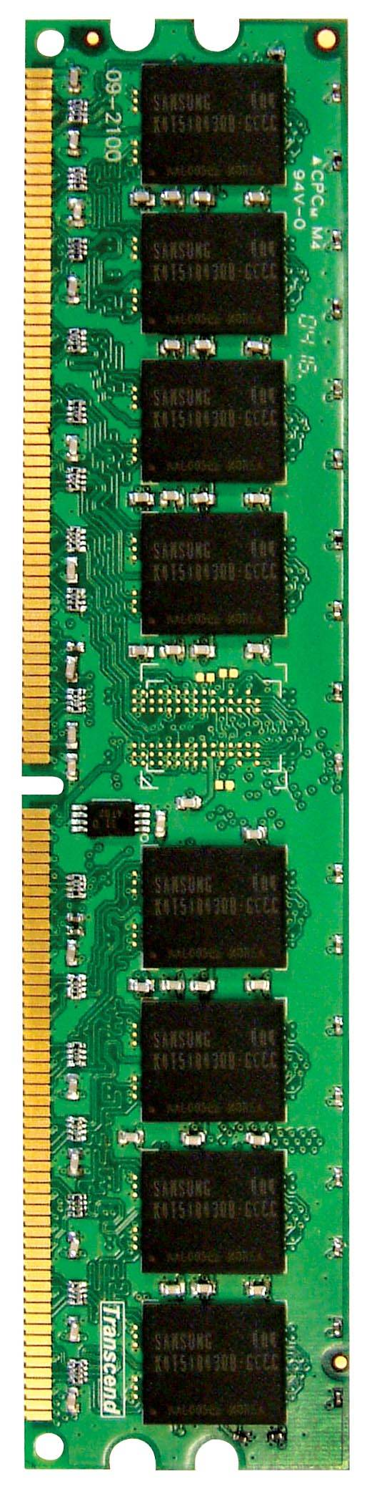
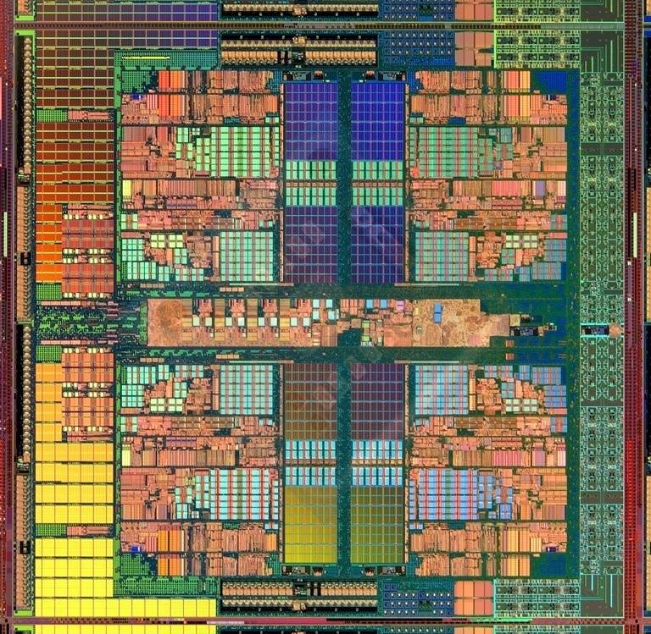
An Example: Multi-Core Systems
Multi-Core
Chip
CORE 0
L2 CACHE 1
CORE 1
L2 CACHE 0
SHARED L3 CACHE
DRAM INTERFACE
DRAM MEMORY CONTROLLER
DRAM BANKS
L2 CACHE 2
CORE 3
CORE 2
L2 CACHE 3
*Die photo credit: AMD Barcelona
3

Slide 4
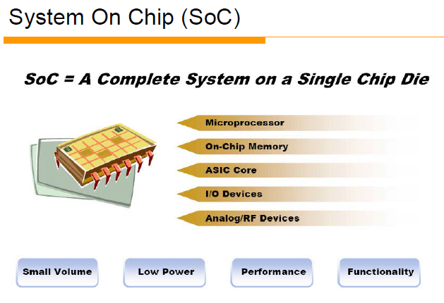

Slide 5
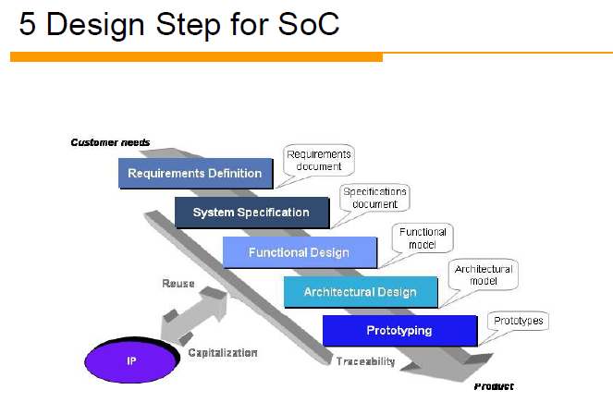

Slide 6
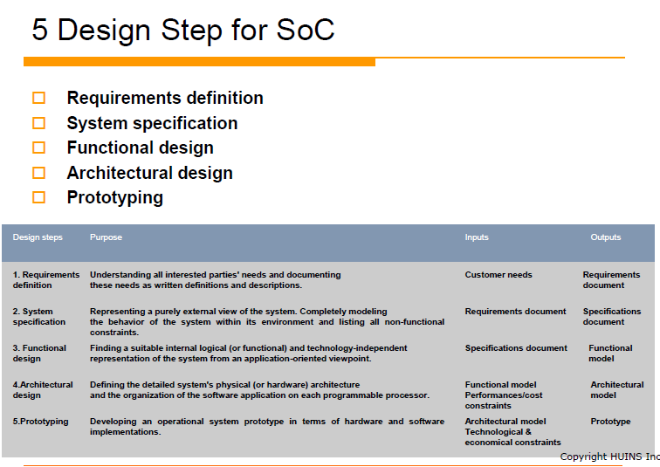

Slide 7
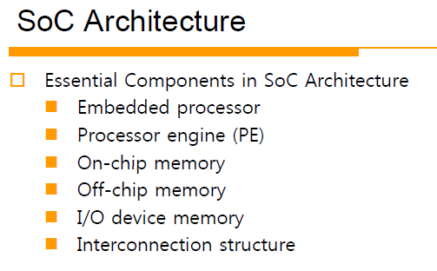

Slide 8
